Slide 1

Simplified form of Davis-Putnam algorithm
Frank van Harmelen
Vrije Universiteit Amsterdam

Slide 2
We need a method to check for satisfiability
We saw in the lecture on propositional logic that:
Problems-to-be-solved can be formulated as a statement in propositional logic
Finding a truth assignment that makes the statement true corresponds to finding solution to the problem (example: solving the diplomatic party problem)
So, we need a method for finding such a set of truth values for simple statements that makes the big statement true (= an assignment that will “satisfy” the big statement)

Slide 3
The truth-table method is too expensive
In the lecture on propositional logic we also learned the truth-table method:
for each of all the possible combinations of the truth values of all the simple statements:
it calculates the truth value of the big statement for each of these combinations
and it checks if one of these combinations satisfies the big statement
The problem with this method is that the number of combinations of truth values is very large.
For N variables, there are 2^{N} combinations:
2¹⁰⁰ = 1.267.650.000.000.000.000.000.000.000.000
and realistic problems have not 100 but 1 million variables!
So we need a more efficient method!

Slide 4
Davis-Putnam algorithm
The Davis-Putnam (DP) algorithm is a more efficient algorithm for finding a satisfying truth assignment.
It assumes that the input statement is in clausal normal form (but we know we can make sure it is).
We need a few new terms:
A “variable” is one of the simple statements (the letters) that make up the input statement
A clause is one of the disjuncts in the big disjunction in the input statement (which is in clausal normal form)
A literal is a variable or its negation (both P and ¬P are literals)
A unit clause is a clause of length 1 (= only one literal)
A pure literal is a literal that occurs in only one clause

Slide 5
Davis-Putnam algorithm
It consists of two stages:
It checks a few easy cases, and if such an easy case exists it can assign the right value to one of the truth values
If there is no such easy case, it picks one of the predicates and picks a truth value to it.
After assigning such a truth value in step 1 or 2, it simplifies the formula,
And then repeats the process with the simplified formula
The process stops
when all clauses have been satisfied (success!), or
when the set of clauses becomes inconsistent (failure)
If there is failure, that could be because we picked the wrong truth value for a letter in step 2. So we have to “backtrack”:
6. for the letter from step 2 we pick the other truth value, and try again.

Slide 6
Davis-Putnam algorithm
The easy cases are as follows:
1.1 if a clause contains ¬P ∨ P it can be removed (because the clause will be satisfied in an case)
1.2 if there is a pure literal (occurring only once), it can be set to true (because this choice doesn’t affect any other clause)
1.3 if there is a unit clause (consisting of only one literal), that literal can be set to true (because this is the only way the clause can be satisfied) (of course, if the literal is of the form ¬P, that makes P false)
Step 2 (picking a truth value for some variable) is called a split
Because it splits the problem in two options, depending on which truth value we choose for the variable.

Slide 7
Example: The diplomatic puzzle
We have to find a satisfying assignment for
(P ∨ ¬Q) ∧ (Q ∨ R) ∧ (¬R ∨ ¬P)
No easy cases, so split. Let’s say P=1
Simplify: (Q ∨ R) ∧ (¬R)
Pure literal Q, so Q=1
Simplify: (¬R)
Pure literal (and unit clause), so ¬R=1, and R=0
Solution: P=1,Q=1,R=0
You can easily check that this does indeed satisfy the input formula.
Therefore: invite Peru and Quatar, but not Rumania

Slide 8
Example: The diplomatic puzzle
We could have made another split choice in the first step:
(P ∨ ¬Q) ∧ (Q ∨ R) ∧ (¬R ∨ ¬P)
No easy cases, so split. This time let’s say R=1
Simplify: (P ∨ ¬Q) ∧ (¬P)
Pure literal ¬Q, so ¬Q=1, so Q=0
Simplify: (¬P)
Unit clause (and pure literal), ¬P=1, so P=0
Solution: P=0,Q=0,R=1
You can easily check that this also satisfies the input formula: only invite Rumania
We know from the truth table method that these are the only two satisfying assignments (= the only two solutions to the puzzle)

Slide 9
Another example:
Find a satisfying truth assignment for
((P∨¬R) ∧ (P∨¬Q, R) ∧ (Q∨R∨¬P) ∧ (¬R∨¬P∨ Q))
We can also write this formula as:
((P, ¬R),(P, ¬Q, R), (Q,R, ¬P), (¬R, ¬P, Q))
No easy case, split: let’s choose P=1
Simplify: ((Q,R), (¬R,Q))
No easy case, split: let’s choose Q=0
Simplify: ((R), (¬R))
Unit clause: R=1
Simplify: when a clause contains a true letter, remove the clause from the formula when a clause contains a false letter, remove the letter from the clause ((()) false! We must backtrack to our most recent choice, which was Q=0, and change it to Q=1

Slide 10
Another example (continued)
We had ((Q,R), (¬R,Q))
Now split with Q=1
Simplify: all clauses satisfied, success;
Thus: P=1,Q=1 satisfies the original formula.
Notice that this is independent of the value of R.
So there are two full solutions:
(P=1,Q=1,R=1) and (P=1,Q=1,R=0)

Slide 11
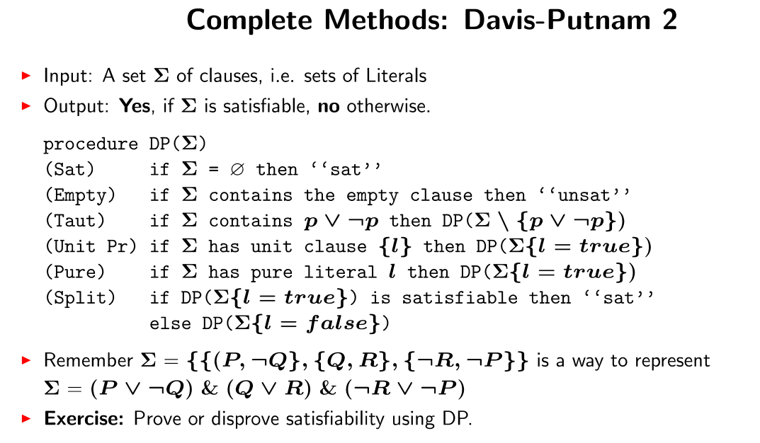

Slide 12
